Slide 1
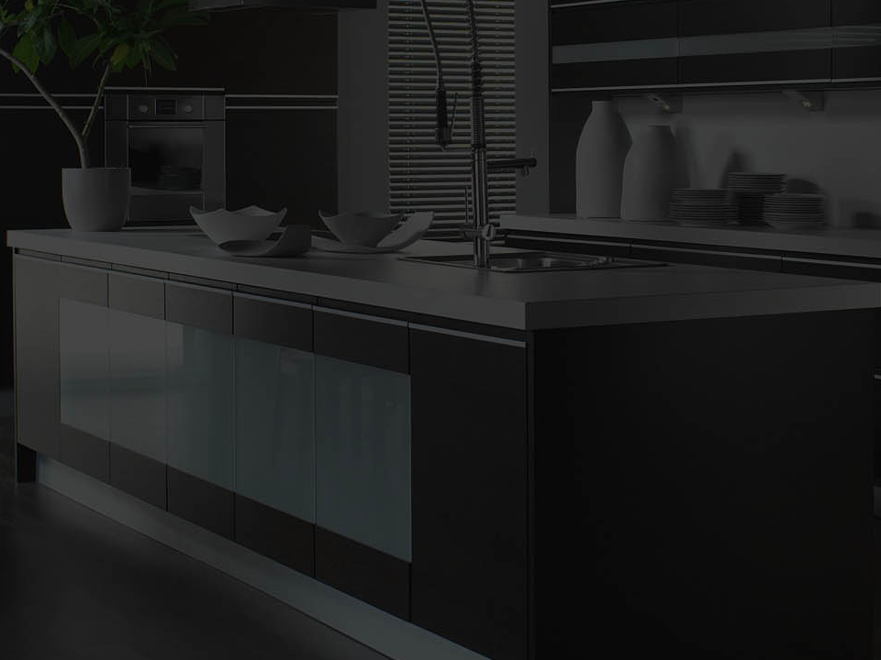
MASSIVE SAVINGS
Upgrade to Stone For the Price of Laminate
ON ALL NEW KITCHEN PURCHASES
HURRY! LIMITED STOCK ONLY*
*OFFER ONLY VALID ON AVAILABLE STOCK
Call 1300 027 337
TO BOOK YOUR APPOINTMENT TODAY

